Slide 1


IEEE x Knight Hacks Embedded Workshop!
https://discord.gg/hAGRkgEBZQ
Arduino IDE and Driver Installation Guide
IEEE Discord Link
Github Link

Slide 2
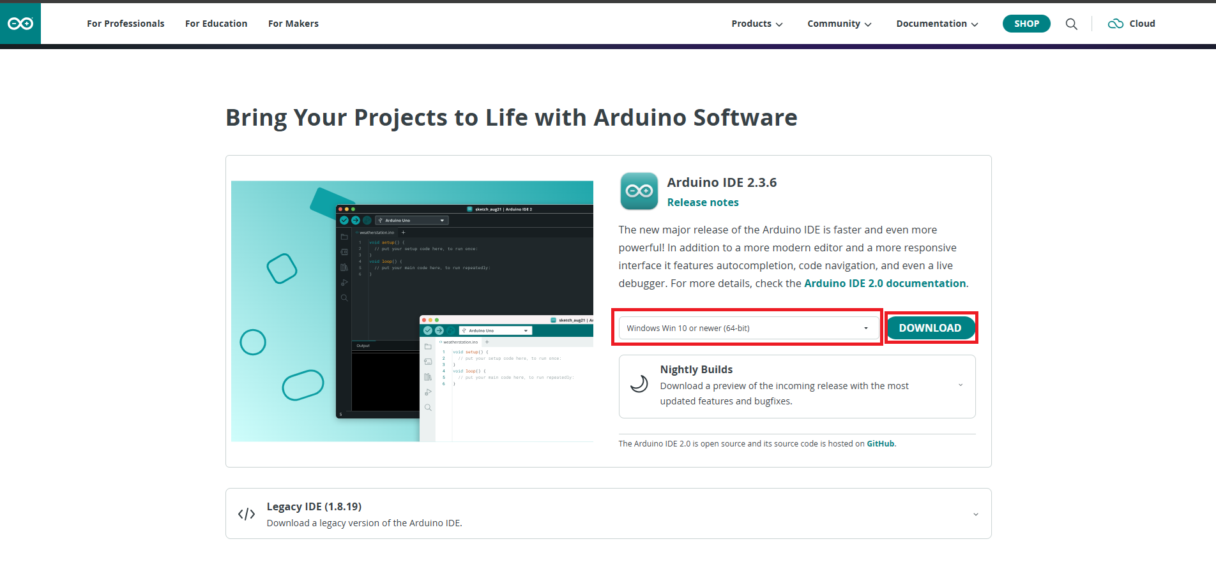
How to Install and Configure the Arduino IDE
Select your OS and click “DOWNLOAD”
Link: https://www.arduino.cc/en/software/

Slide 3
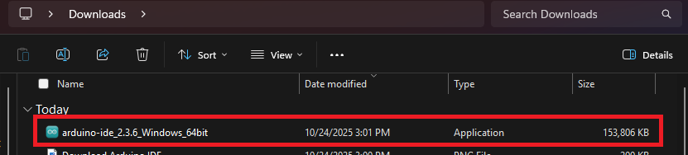
How to Install and Configure the Arduino IDE continued...
Next, run the installer!

Slide 4
Additional slide:
Go to File, Then Preferences, then in Additional Board Manager URL's, Paste this:
https://espressif.github.io/arduino-esp32/package_esp32_index.json

Slide 5
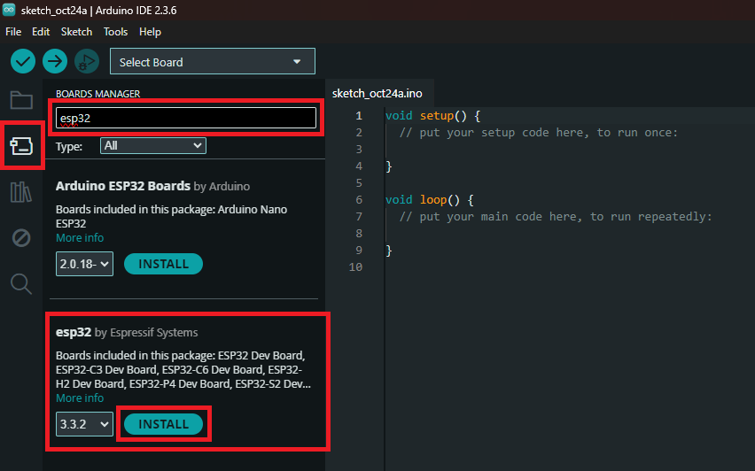
How to Install and Configure the Arduino IDE continued...
Open the IDE > Select the “Boards” tab > search “ESP32” > Install the “esp32” pack by Espressif Systems

Slide 6
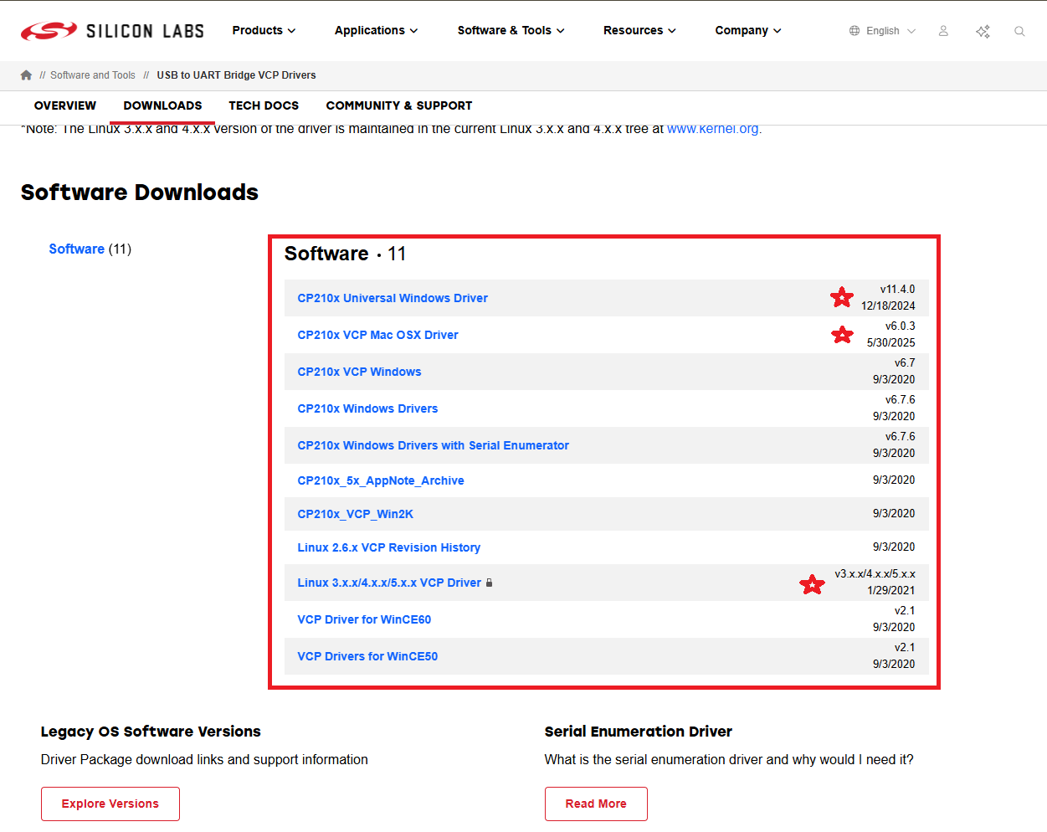
How to Install and Configure the Drivers...
Download the appropriate driver based on your OS Link: https://www.silabs.com/software-and-tools/usb-to-uart-bridge-vcp-drivers?tab=downloads

Slide 7
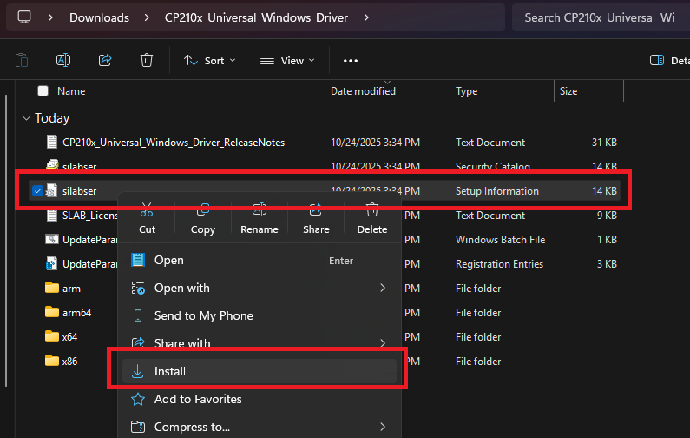
How to Install and Configure the Drivers continued...
Extract the folder > Run the “silabser” .inf/setup information file installer (right-click and select “install”)

Slide 8
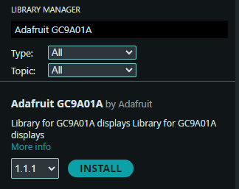
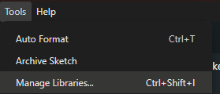
How to Install and Configure the IDE with Libraries...
Once you load the IDE, go to tools and go to manage libraries.
You will see a library manager pop up, in the search bar, type in “Adafruit GC9A01A”

Slide 9
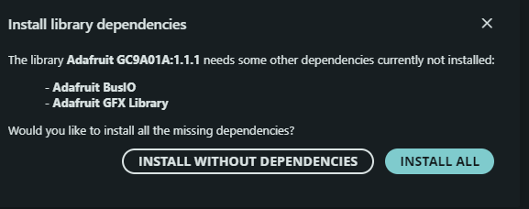
How to Install and Configure the Arduino IDE continued...
It will ask you to install 2 additional libraries, press INSTALL ALL.
The Display in Session 2 will not work without it. :(

Slide 10
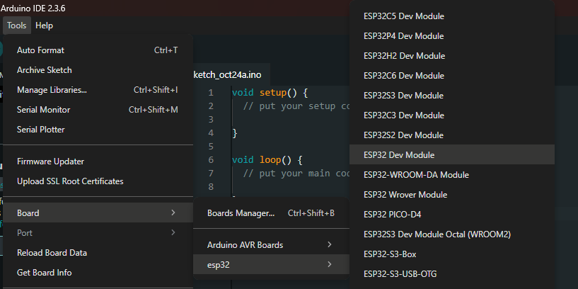
How to Install and Configure the Arduino IDE continued...
Go back to tools, then go the the board section, then hover over ESP32, then select “ESP32 Dev Module”

Slide 11
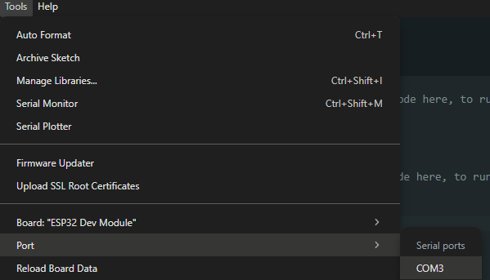
How to Install and Configure the Arduino IDE continued...
Then, once you have selected the correct board, you will see you finally have the option to select a Port. Select the COM3 Port.

Slide 12
And then you’re done! :)

Slide 13



QR Codes!!!!!
Feedback Link
IEEE Discord Link

